Slide 1
Analysis of Glassdoor Reviews for S&P Global

Slide 2
Agenda
Executive Summary
Overview
Good Words about the Organization
Area of Improvement
Appendix

Slide 3
Executive Summary
Objectives
Identify hidden issues that might impacting employee engagement.
Key Observations
Overall Employees were satisfied with 3.2 Average overall satisfaction (out of 5).
Hot topics are Work Life Balance, Management, Work environment, People, Benefits, Brands, Leadership, Salary, Opportunities etc.
50% of the reviews are from US and India employees.

Slide 4

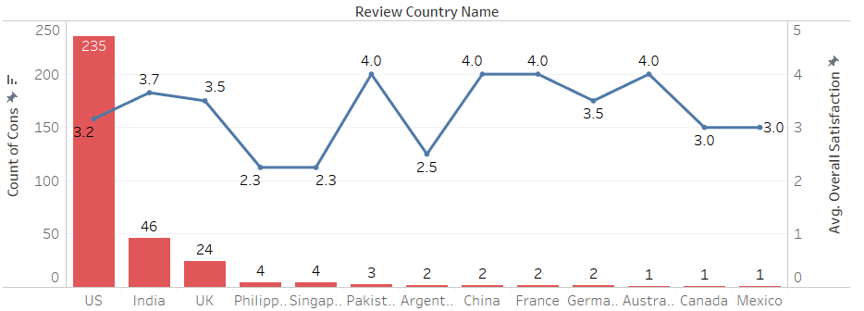
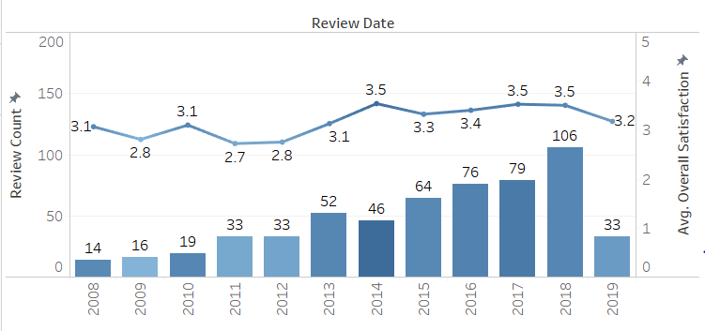
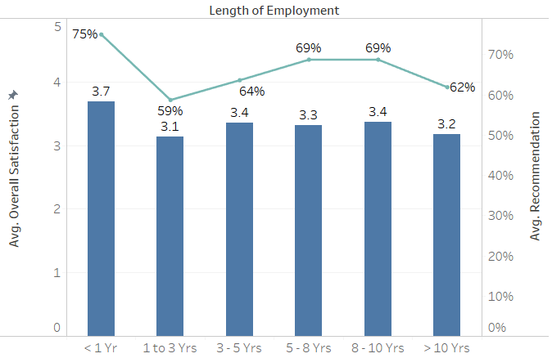

Overview
571
129
~ 5
41%
53%
47%
47%
81%
Reviews by former &
current employees
# Months
Average monthly reviews
Is the % of the employee from US
Of the reviews from current employees
Of the reviews from former employees
Avg. Recommender
Score
Approved Current CEO (on an Average)
Major Reviews were from US and India and Avg. Overall Satisfaction rate was good except few Countries
Employees were more vocal from 2012 onwards, As Review Count increasing, Avg. Overall Satisfaction ratio and Avg. Recommendation is also increasing
People spending more time in the company are recommending more and Avg. recommendation is positively correlated with Avg. overall Satisfaction

Slide 5
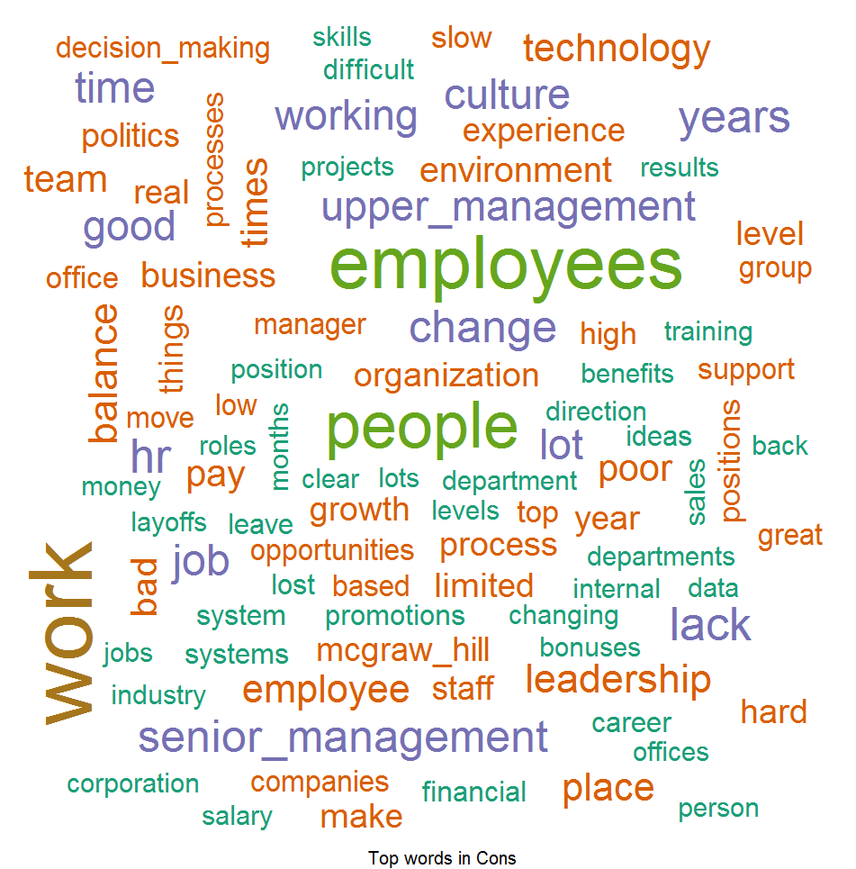
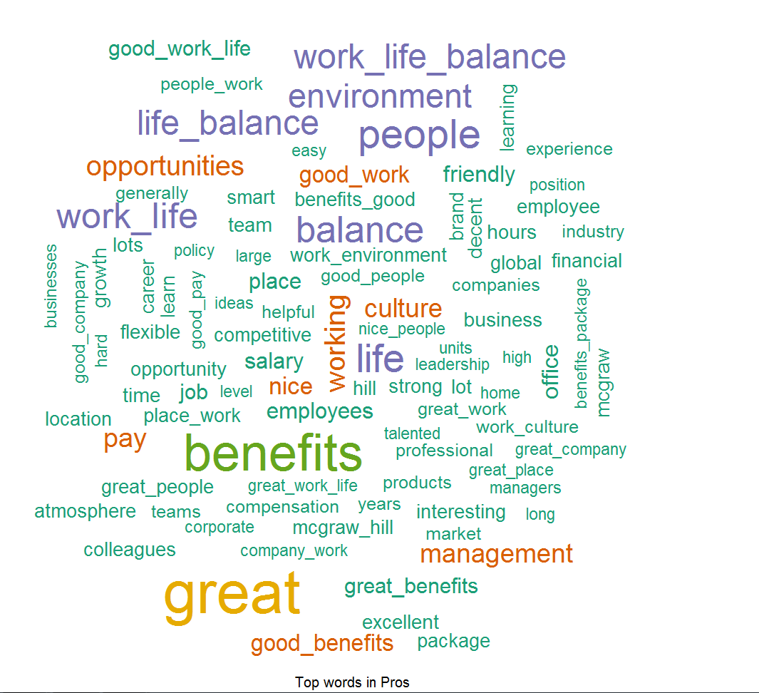
Good Words about the Company
What is Word Cloud
An image composed of words used in a particular text or subject, in which the size of each word indicates its frequency or importance (Color doesn’t signifies anything except differentiator between words).
Word Cloud for Pros
Word Cloud for Cons
Things which Employees liked –
According to Employees feedback, we found out that people love our Benefits, Work Life Balance, Friendly Environment, Culture and Opportunities provided by S&P and they are spreading good words on this front.
Word List which Employees don’t like –
Feedback provided by the Employees they found out to difficulty to cope up with Working Environment, HR Processes, Decision Making, Growth, Promotions and Layoffs and this can be improved.

Slide 6



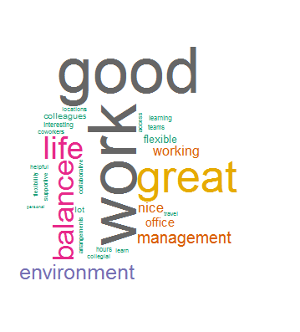
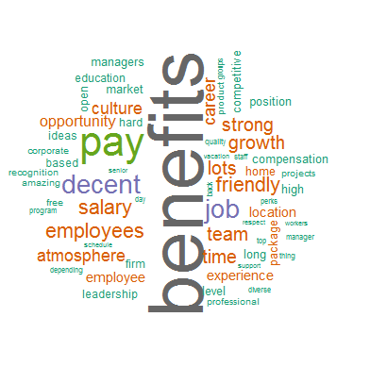
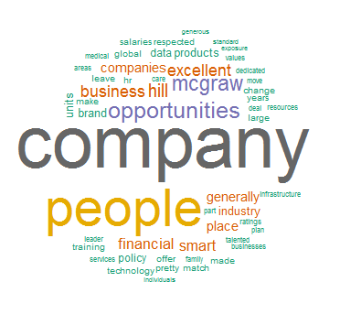
Top 3 Themes – For Pros
There are three themes based on statistical vector-space model for mining abstract “topics” or “themes” occurring in a collection of documents, which they liked –
Theme 1. Employees like Work Life balance, Flexible work, Interesting work etc.
Theme 2. Employees like Benefits, Salary, Culture, Growth etc.
Theme 3. Opportunity, People, Company, Brand, Opportunity etc.

Slide 7
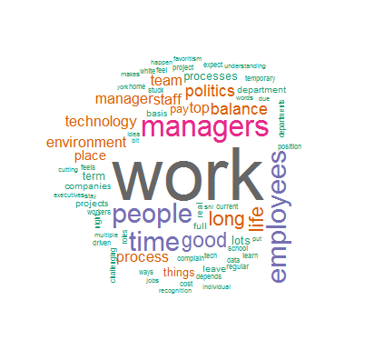
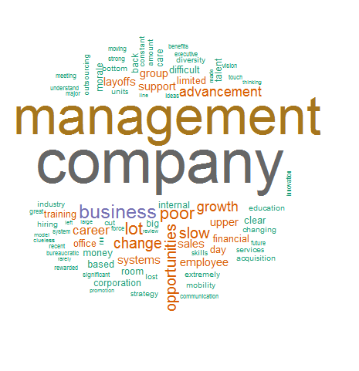
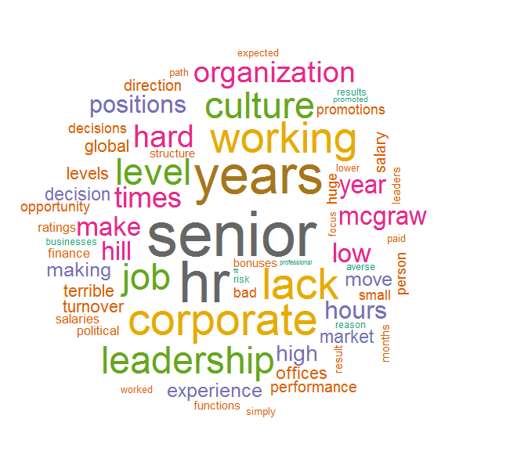
Top 3 Themes – For Cons
There are three themes based on statistical vector-space model for mining abstract “topics” or “themes” occurring in a collection of documents, which employees didn’t liked –
Theme 1. Management, Company, Layoffs, Growth, Opportunities etc.
Theme 2. HR, Culture, Promotions, Salary etc.
Theme 3. Work, Managers, Politics, Pay, Process etc.

Slide 8
Appendix

Slide 9
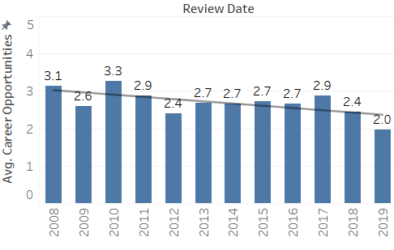
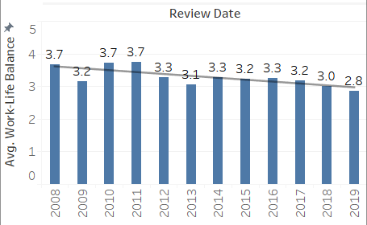
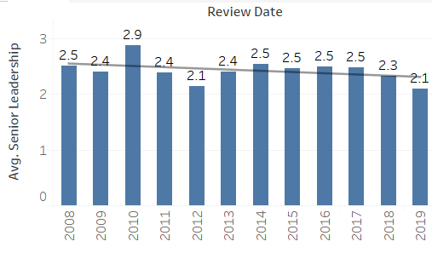
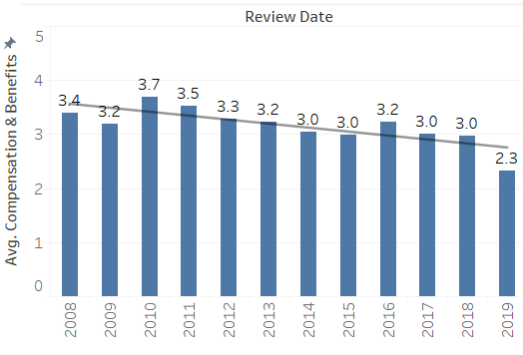
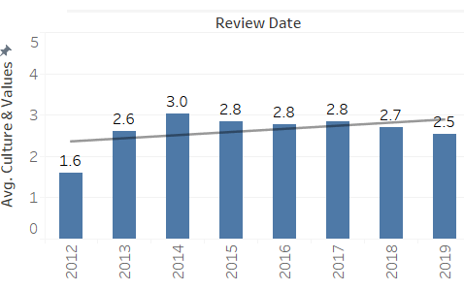
Overview – For 5 Subsections
Avg. Career Opportunity over the Years
Avg. Senior Leadership over the Years
Avg. Work Life balance over the Years
Avg. Comp & Benefits over the Years
Avg. Culture & Value over the Years

Slide 10
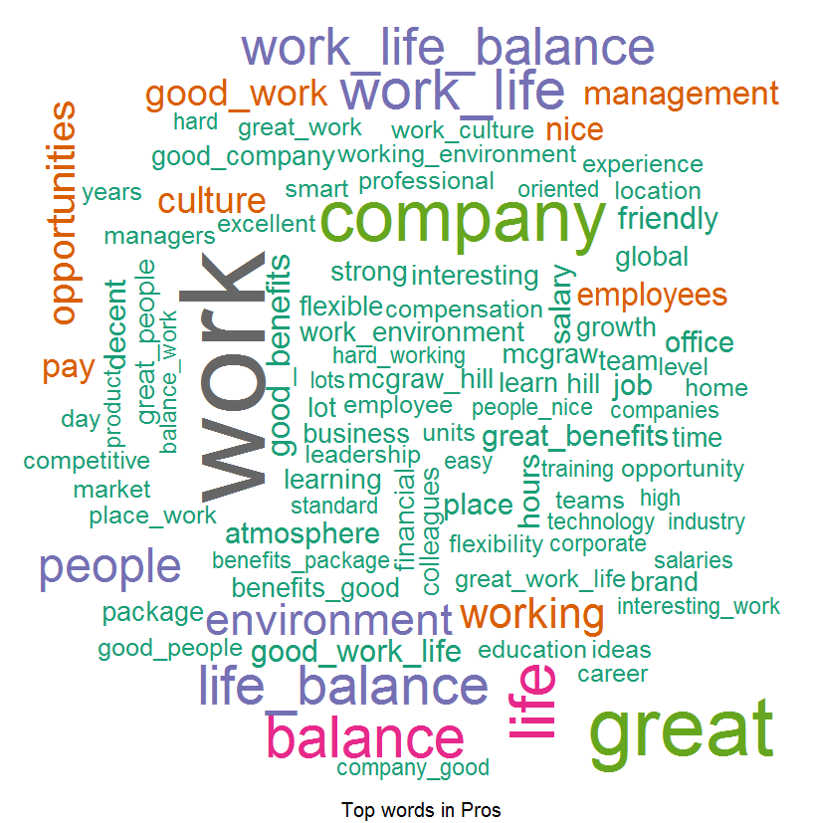
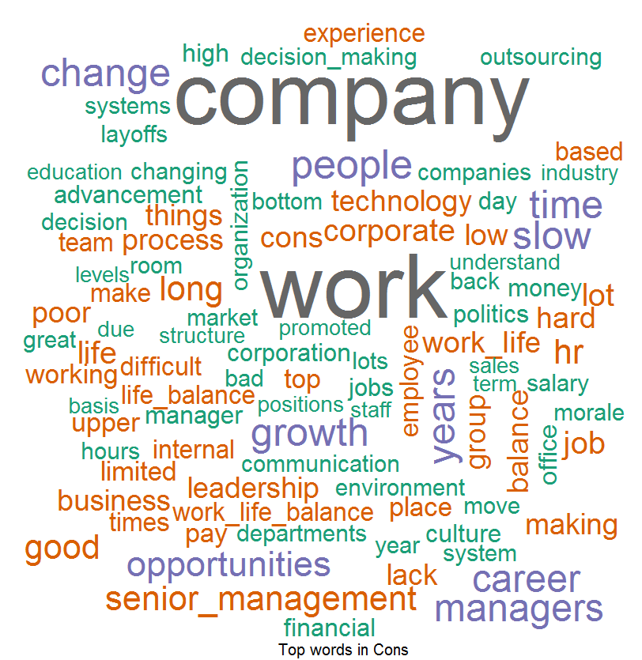
Word Cloud For Current Employees
Word Cloud for Pros
Word Cloud for Cons
Good Words List –
Work Life Balance
Good Work
Environment
People
Word List which people don’t like –
Work
Growth
Opportunities
Decision Making

Slide 11
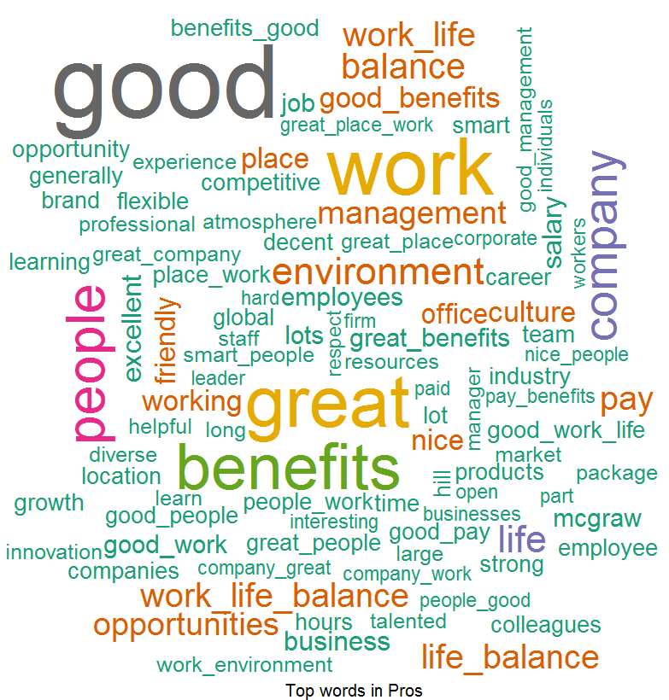
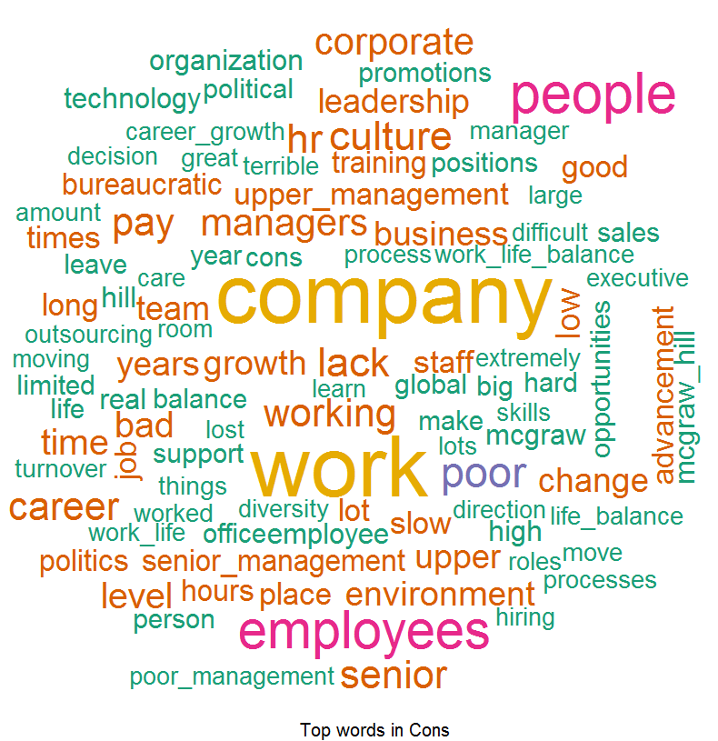
Word Cloud For Former Employees
Word Cloud for Pros
Word Cloud for Cons
Good Words List –
Work Life Balance
Good Benefits
Environment
People
Word List which people don’t like –
Growth
Culture
Politics
Bureaucratic Manager
Career Advancement

Slide 12
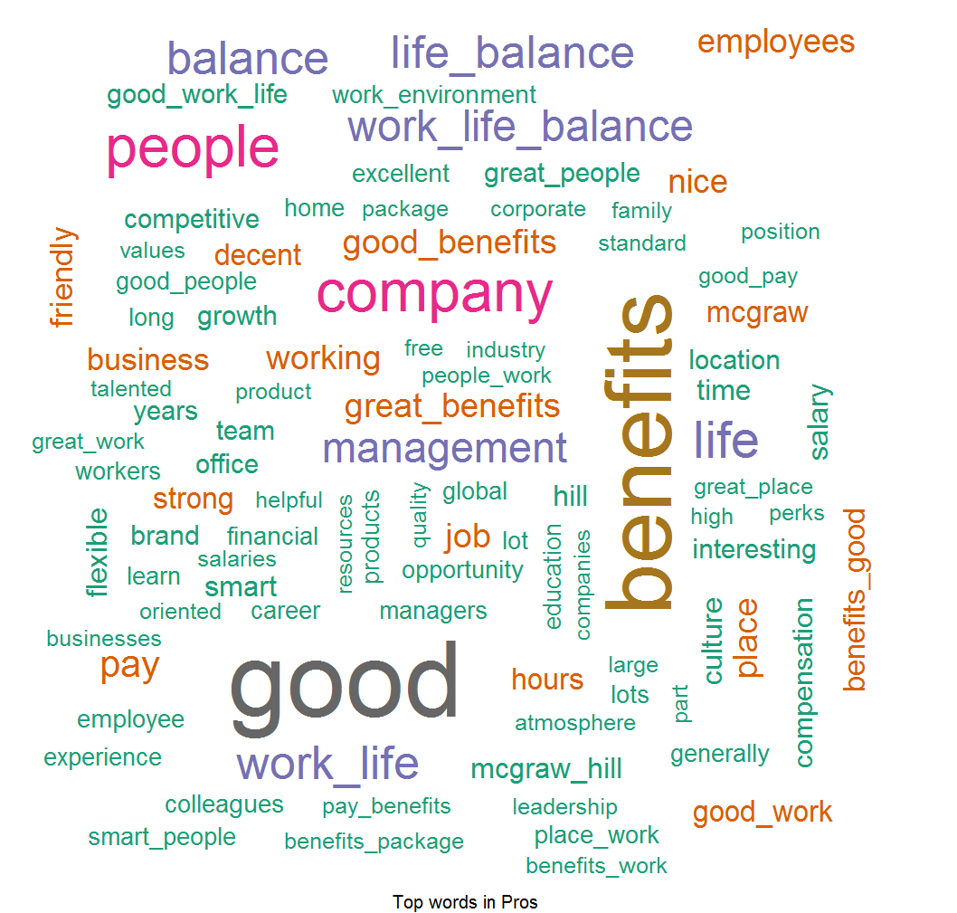
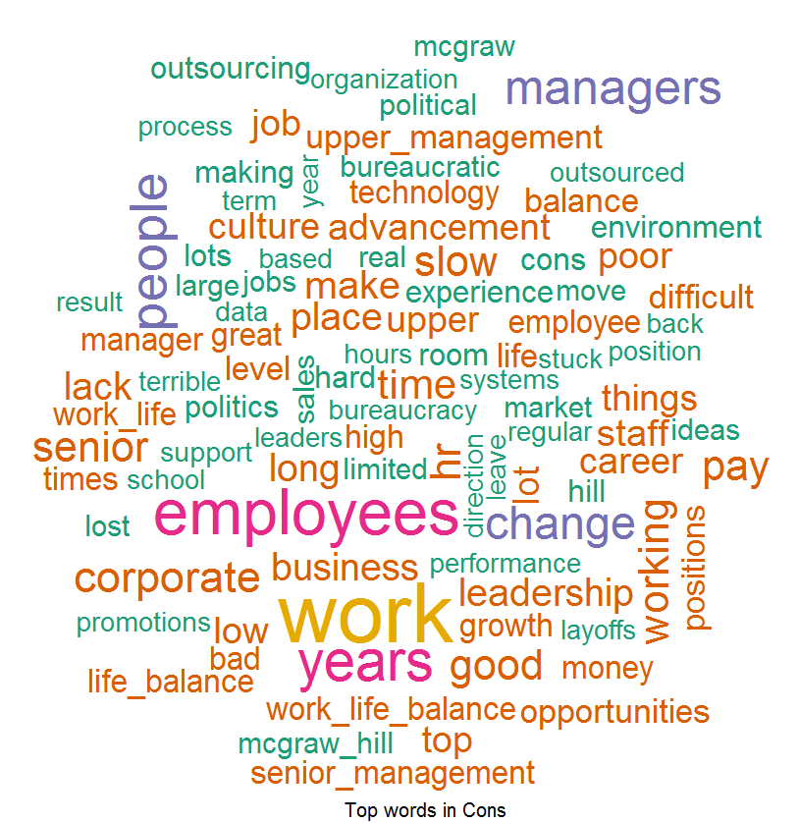
Word Cloud For US
Word Cloud for Pros
Word Cloud for Cons
Good Words List –
Work Life Balance
Great Benefits
Good Pay
Work Environment
People
Word List which people don’t like –
Opportunities
Politics
Promotions

Slide 13
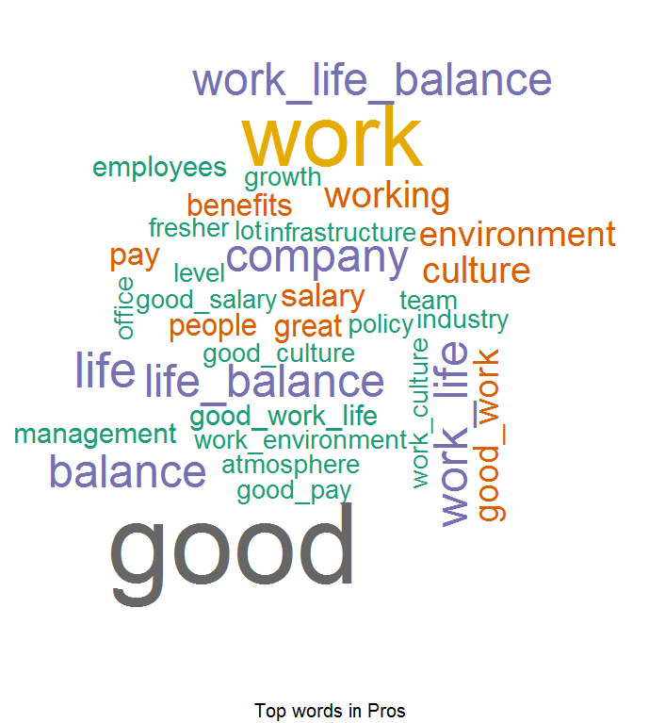
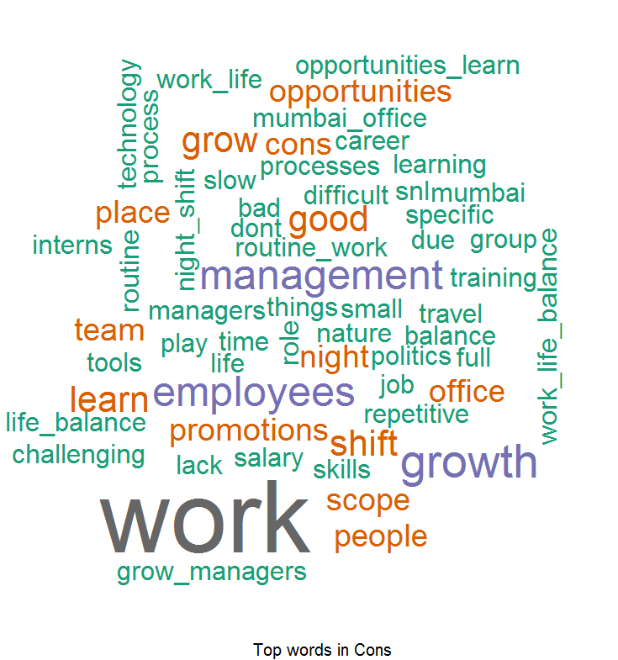
Word Cloud For India
Word Cloud for Pros
Word Cloud for Cons
Good Words List –
Good Work Life Balance
Growth
Good Pay
Culture
Policy
Word List which people don’t like –
Opportunities
Promotions
Learning Opportunity
Training

